Slide 1
Changes to IMPROVE RHR Calculations and Metrics since 9_24 version
Scott Copeland 9_9_2025

Slide 2
Update for version “_9_25”:
KPBO1 and LOND1 have new e95 thresholds for carbon based on the 2024 data, hence have updated impairment metrics for their respective data records. The only noted changes to MID values were KPBO1 2016 and LOND1 2017. Other years were not affected. (The same days were still chosen as “Most Impaired”.)
Three new sites were added to the Impairment Metrics files, PITT1, ATLA1, and SOGP1, which now have the required 5 complete years to calculate the necessary e95 values. The impairment maps will be updated to reflect the new sites’ data back to 2018.
A new “ZION_RHTS” data set has been added to the RHR metrics calculations. Like the other “_RHTS” sites, this is a combination of the ZION1 and ZICA1 data sets. This is the first case where data from ZION1 (old site) was scaled to be consistent with data from ZICA1.
CAVE1, DINO1, FCPC1, KPBO1, LOND1, LTCC1, MAKA2, NOGA1, OWVL1, STIL1, SYCA2, and TOOL1 have updated default 2064 endpoints. Sites with fewer than 15 years of data are updated as data becomes available. The changes are minor¹.

Slide 3
¹ Minor changes to EP values.

Slide 4
Changes to IMPROVE RHR Calculations and Metrics since 10_23 version
Scott Copeland 9_9_2024

Slide 5
Update for version “_9_24”:
Three new sites were added to the Impairment Metrics files, CAVE1, DINO1, and TOOL1, which now have the required 5 complete years to calculate the necessary e95 values. The impairment maps have been updated to reflect the new sites’ data back to 2018.
FCPC1, KPBO1, LOND1, LTCC1, MAKA2, NOGA1, OWVL1, STIL1, and SYCA2 have updated default 2064 endpoints. Sites with fewer than 15 years of data are updated as data becomes available. The changes are minor¹.

Slide 6
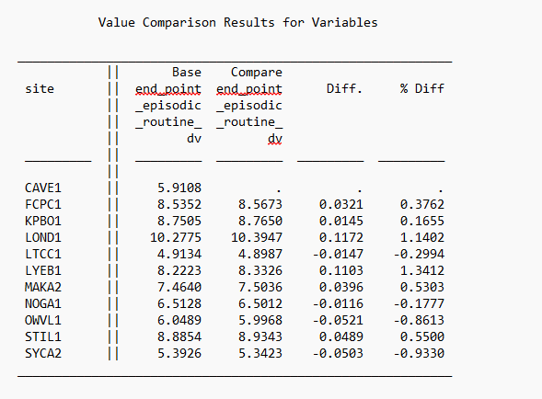
¹ Minor changes to EP values.

Slide 7
Changes to IMPROVE RHR Calculations and Metrics since 12_22_2 version
Scott Copeland 10_11_2023

Slide 8
Update for version “_10_23”:
One new site was added to the Impairment Metrics files, NOGA1, which now has the required 5 complete years to calculate the necessary e95 values.
FCPC1, KPBO1, LOND1, LTCC1, MAKA2, NOGA1, OWVL1, STIL1, and SYCA2 have updated default 2064 endpoints. Sites with fewer than 15 years of data are updated as data becomes available. Usually the changes are minor.
SYCA2 has new e95 thresholds based on the 2022 data, hence has updated impairment metrics for 2016-2021. This does not affect the SYCA_RHTS combined site data.
There is a new native QA flag of “SD” for short duration, when the sampler senses a reduced flow rate and shuts of the affected module. These samples will not be used for RHR metrics (at least for now), but represent a very interesting dataset.

Slide 9
Impairment group means files finally include a new variable “Number_obs”, the number of valid observations used for each reported mean value.

Slide 10
Changes to IMPROVE RHR Calculations and Metrics since 2_2021 version
Scott Copeland 12_13_2022

Slide 11
Update for version “_12_22_2”:
Four new sites were added to the Impairment Metrics files. The sites are FCPC1, KBPO1, SYCA2, and LTCC1.
These sites have the requisite 5 years of complete data to calculate the e95 and 2064 end point values, but the algorithm was not properly including them.
Years affected are
KPBO1 | 2016-2021
LTCC1 | 2015-2021
FCPC1 | 2017-2021
SYCA2 | 2016-2021

Slide 12
Deliver notes below only affect previous year data at BLIS1 which has changed only site code to BLIS2 effective 1/1/2020. All other changes are with respect to preliminary data from 2021.
Various | Various | Various | N/A | N/A | For various months and various analyses, field blank statistics used in the initial deliveries were invalidated and were recalculated for redelivery because individual filters changed after original delivery (e.g. due to reanalysis/reweigh, status change, swaps) or insufficient number of field blanks were available at the time of original processing.
BLIS1/2 | 1/21/2020 - 11/30/2021 | All | N/A | N/A | This site moved to a temporary location at the beginning of 2020. However, the samplers are still at their temporary location so it was decided to make this a new site. The 2021 data has been updated accordingly to be associated with the new site. Data in AQS has been moved from being associated with BLIS1 monitors to being associated with BLIS2 monitors between the two dates. NPS has been contacted to determine how to handle the data.
Various | January 2021 - June 2021 | A | XX | NM | A total of 71 filters were originally delivered with the elements Al, Cl, P, S, and Si invalidated with the XX status because of a suspected analysis issue. The source of the analysis issue is known and is suspected to impact more filters than the 71 filters identified during validation of 2021 data, however the impact on the reported data is thought to be minimal. For the redelivery 68 of the originally identified 71 filters had the XX status removed from the Cl, P, S, and Si elements, leaving Al as it was originally delivered. For three filters, all elements were re-validated as they were deemed to not be impacted by the issue. Investigations and analysis are ongoing.
All | June 2021 - December 2021 | A | N/A | N/A | HIPS data (fAbs parameter) have been excluded from the skinny redelivery files between June 2021 and December 2021 while investigations are ongoing into suspect results. The data will likely be redelivered at a later date. Please do not use the fAbs data in the wide format files between June and December 2021.

Slide 13
By request, group means files now include a new variable “Number_obs”, the number of valid observations used for each reported mean value.
Explicitly added site specific Rayleigh (ss_Rayleigh) values to group means files.
No other changes to data or algorithm for this process.

Slide 14
Changes to IMPROVE RHR Calculations and Metrics since 12_2020 version
Scott Copeland 2_7_2022

Slide 15
*affects DOSO1 2020 samples only*
This issue is isolated to DOSO1’s 2B Module. Starting 05/06/2020, our electronic Flow Data suggested a flow decrease that continues over the next two sampling days, through 05/13/2020; this is evidenced by the primary pressure-sensing channel, while the secondary channel did not respond as expected. On 05/14/2020, the Operator followed the Field Group’s instructions in an attempt to readjust the flow; this flow adjustment was based on data from the primary channel. After this flow adjustment, the secondary channel’s data did not return to expected values.
On 09/18/2020, the electronic flow data showed another flow increase; this is evidenced by the primary channel, while the secondary channel did not respond at all. The Operator performed another flow adjustment on 09/22/2020 to decrease the flow back down to expected values based on data from the primary channel. The crucial difference between this second flow adjustment and the initial one is that after the second adjustment, both pressure-sensing channels returned to the original expected values.
A-to-B inter-module analysis-data comparisons did not agree well from 05/14/2020 to 09/22/2020, all days between the two Operator-prompted flow adjustments.
From 05/13/2020 to 09/22/2020, after the initial flow adjustment but before the second adjustment, the primary channel suggested a valid flow rate, but the secondary pressure-sensing channel suggests that the flow rate did not return to expected values. This shows that there was a problem that affected only the primary channel, but did not affect the flow rate. This was further verified on 09/18/2020 and 09/21/2020 when the primary channel shifted upwards, but the secondary channel did not respond. We know that the flow rate did not change because the secondary channel did not respond, but the flow obstruction affecting only the primary channel fixes itself. After the second flow adjustment on 09/22/2020, both the primary and secondary channels return to their original values.
The table below summarizes our findings and the state of the flow rate. A-to-B inter-module analysis-data comparisons do not agree for all times that the flow rate was set high at ~29 LPM.
Sampling Date Range Details
before 5/6/2020 Primary channel reliable. Flow rate at 23 LPM.
5/6/2020 5/12/2020 Primary channel unreliable. Flow rate unchanged at 23 LPM.
5/15/2020 9/15/2020 Primary channel unreliable. Flow rate elevated to ~29 LPM.
9/18/2020 9/21/2020 Primary channel reliable. Flow rate elevated at ~29 LPM.
9/24/2020 onward Primary channel reliable. Flow rate at 23 LPM.
Up until 05/13/2020, despite what the primary channel data showed, we know that the flow rate was unchanged at ~23 LPM because the secondary channel did not shift. When the primary channel problem fixes itself for 09/18/2020 and 09/21/2020, we know that the flow rate is ~ 29 LPM. Because the primary channel and secondary channel values return to expected ranges after the flow adjustment starting 09/24, we confirmed that both the primary channel was providing reliable data. Furthermore, that allows us to know that the 09/18/2020 and 09/21/2020 primary channel data is reliable. The secondary channel has been stable for the duration of this problem and remained unchanged from 05/15/2020 to 09/21/2020 shift, so we know that the flow rate is unchanged during that time. All this confirms that the accurate primary-channel flow rate readings ~29 LPM from 09/18/2020 and 09/21/2020 apply for all of 05/15/2020 to 09/21/2020.

Slide 16
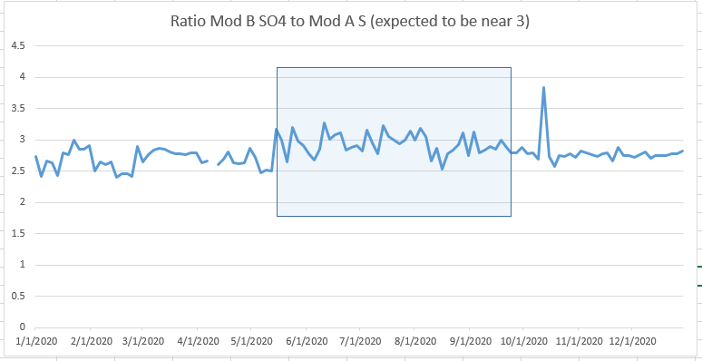
Concentrations for B module during the period affected by high flows were delivered with “SA” flag and processed as “NM” to evaluate the data.

Slide 17
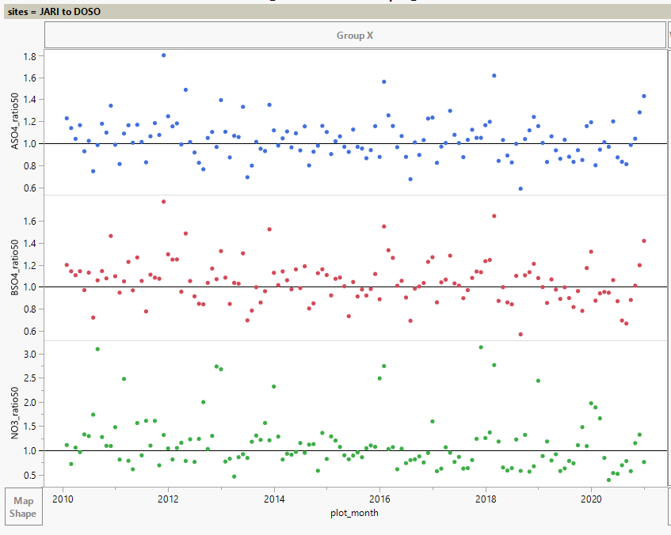
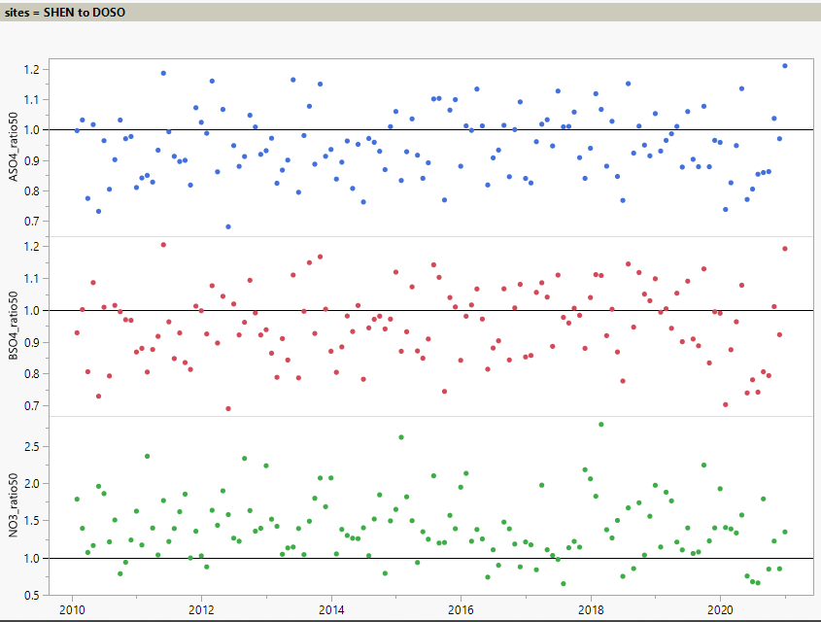
There is no obvious shift in ratios of B module data compared to nearby sites. A module sulfur is provided as a reference for unaffected data.
Only the nitrate values are used for RHR metrics.
Provided they are properly measured, elevated flows would be expected to produce somewhat lower concentrations due to a reduction in particle size cut point. That would cause higher ratios on this plot, not lower.
Period affected

Slide 18
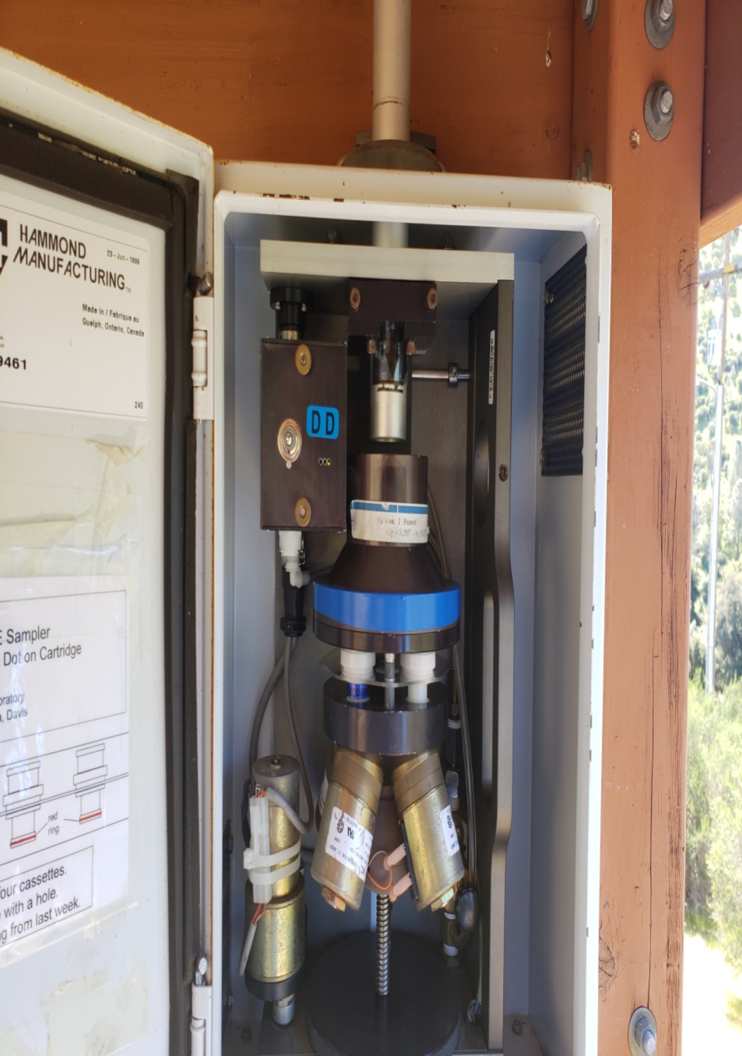
*affects PINN1 2019 samples only*
1/2019-2/2019 MT values at PINN1 were changed from “SA” to “NM”
The same issue affects data from 11/16-12/31 2018, however 2018 was a complete year without restoring these samples, so they remain coded “SA” (not valid for RHR metrics).
See plots on next slide.

Slide 19
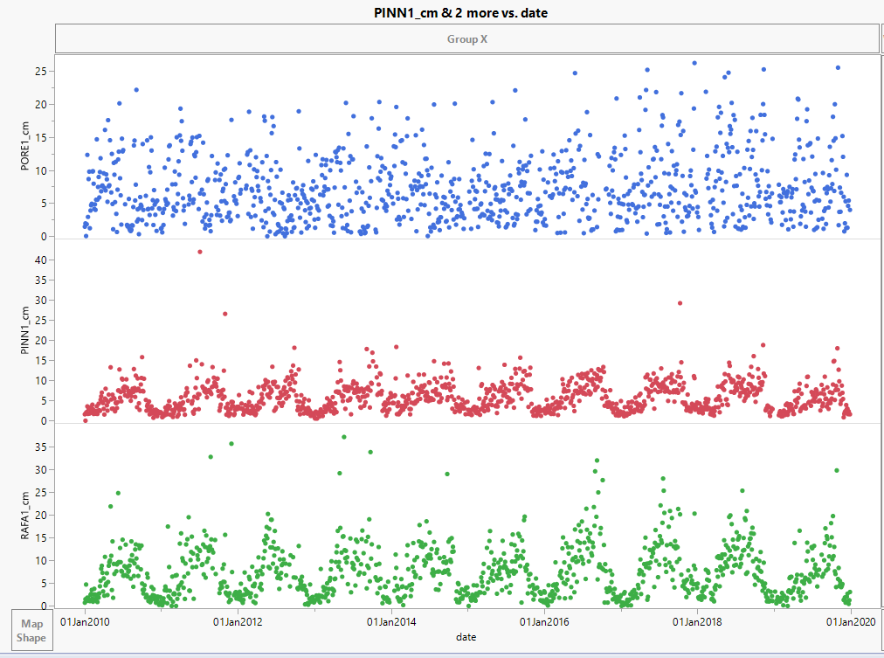
From Nicky Young at AQRC 12/9/2020:
“Our records indicate that during a site audit, it was discovered that the D-Module inlet stack was not inserted all the way during the time period of November 16, 2018 to April 10, 2019. “
Approximate period affected

Slide 20
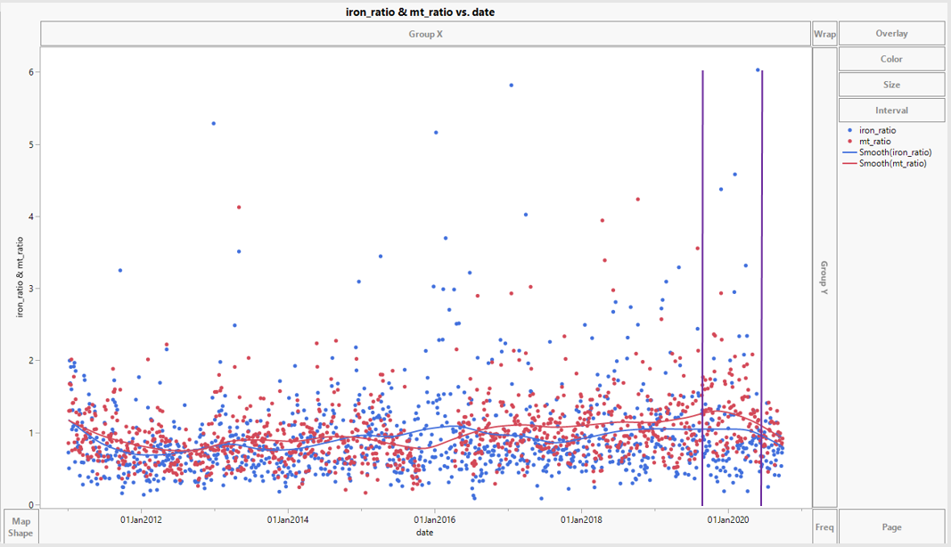
LASU2 Module D had incorrect critical orifice from 8/20/2019 to 5/5/2020. Although the inlet cut point is suspect, the data do not appear out of range, and are used for RHR metrics at LASU2 in 2019. A separate, unrelated issue is expected to cause many of the MT values to be unusable in 2020.
Ratio of LASU2 to VILA1 fe_f, MT

Slide 21
The following note affects Fabs uncertainty values at almost every site in 2019. Fabs uncertainty does not affect daily extinction calculations or RHR metrics.
From UC Davis AQRC:
  “An error in the data processing code was identified that resulted in the incorrect uncertainty values to be reported for filter absorption from HIPS (Fabs) between January 2019 and May 2020. The multiplicative term of the uncertainty was not being properly applied. The error has been corrected and the uncertainty values for HIPS for the sampling time period 2019 through April 2020 have been updated.

Slide 22
Changes to IMPROVE RHR Calculations and Metrics since 4/20_2 version
Scott Copeland 12_8_2020

Slide 23
Certain newer sites will see impairment metrics change as new years are added to 15 year period for determining 95%ile E3 values.
LOND1, LYEB1, MAKA2, and STIL1 impairment metrics were affected by adding the 2019 data.
LYEB1 is a Regional Haze Tracking site, but when combined with legacy LYBR1 site, as LYBR_RHTS the impairment metrics are not affected.

Slide 24
New informational flag added
Flag is “TO” for Time Outside of normal bounds”.
Sample Duration differs from 24 hours by 1-6 hours.
Data is considered valid.
Previously this deviation from normal sampling could only be deduced from the sample duration value, now it is flagged explicitly.

Slide 25
*affects LASU2, RUBI1, FRES1 2004 samples only*
-Site specific Rayleigh values were added to samples at RUBI1, LASU2, and FRES1 for samples in 2004.
-Allows calculation of dv for approximately 70 samples.
-Does not change any Regional Haze Rule metric data.

Slide 26
Changes to IMPROVE RHR Calculations and Metrics since 12/2019 version
*affects AGTI1, HOOV1, IKBA1, WHPE1, SWAN1 and LTCC1 only*
Scott Copeland 4_23_2020

Slide 27
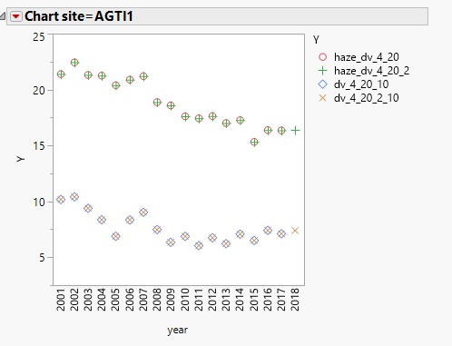
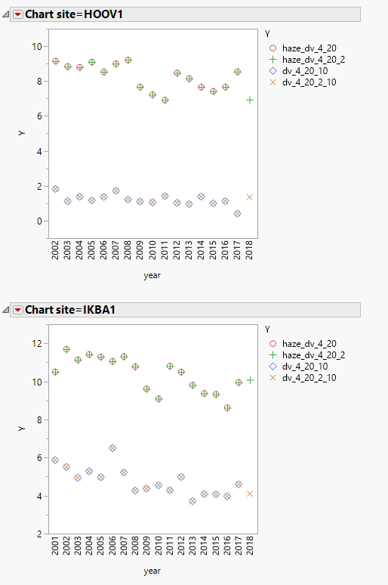
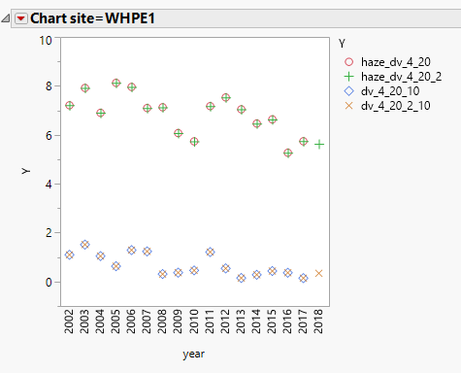
Data Substitution performed by Air Resource Specialists, Inc. for WRAP at four western IMPROVE sites in 2018.
Clearest and Most Impaired Days are now calculated for these years at these sites.

Slide 28
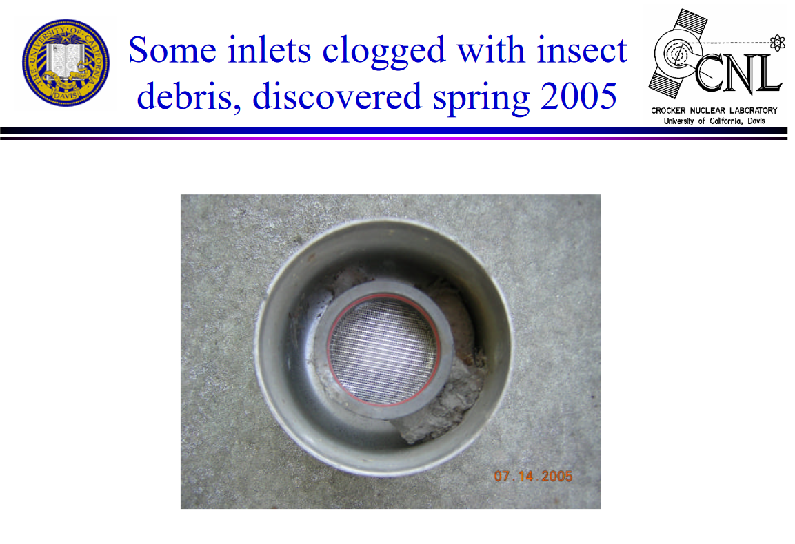
The problem: Insect debris clogged inlets of samplers at Chassahowitzka FL, Mingo MO, and Swanquarter NC in the 2003-2005 timeframe.
- Much data at all three sites was invalidated, but the QA tests failed to find a problem with the module C data at Swanquarter.
Slide from IMPROVE Steering Committee meeting in fall 2005

Slide 29
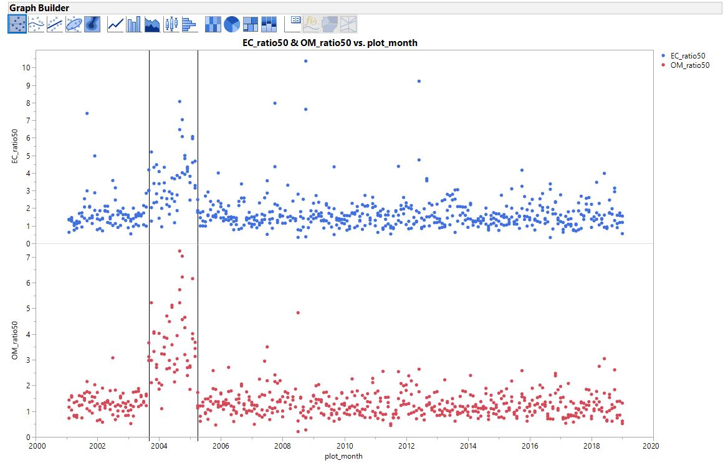
This plot shows the problematic data. These are the median ratios of OMC and LAC at ROMA1, BRIG1, and LIGO1 to OMC and LAC at SWAN1. Three data points in each plot per month, 1 for each site, each point is the median for that month of OMCSITE/OMCSWAN or LACSITE/LACSWAN.
Period with abnormally high ratio is August 2003 through March 2005, shown by vertical lines.

Slide 30
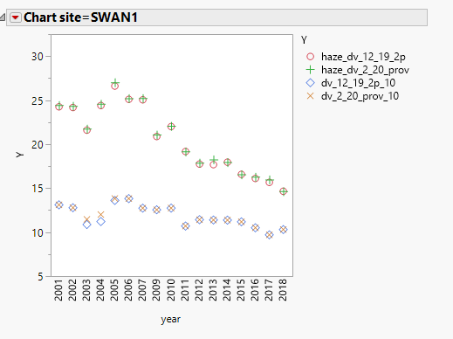
I reran all the RHR metric codes, with each daily OMC or LAC value being multiplied by 2.5 from 8/1/2003 to 4/1/2005. Rerun includes e95 calculation, baseline, NC2, 2064 endpoints, etc.
Comparison of SWAN1 MID dv done with daily OMC and LAC scaled by 2.5 during inlet mud clogging 8/1/2003-4/1/2005.
Using the 2.5 factor barely changed the MID baseline and 2064 endpoints. There was a slight increase in baseline clearest (visible in plot, but no table provided).
2001-2004 MID Baseline
2064 Endpoints

Slide 31
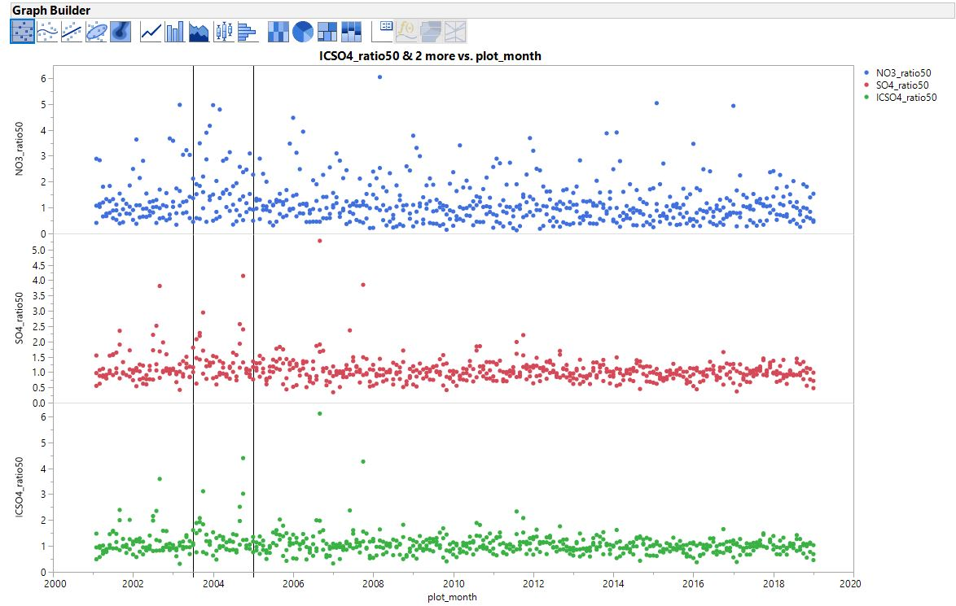
The Module A data for that period was flagged as invalid, and subsequently filled in by data substitution. This plot shows why I don’t think the Module B data at SWAN1 was affected significantly (hence requiring substituting the NO3- data). Same plot of ratios to nearby sites, except done for IC NO3-, IC SO4– and the derived variable Amm_SO4 which is a mixture of XRF S and SO4-. The vertical lines are near, but a bit off of the true period affected.

Slide 32
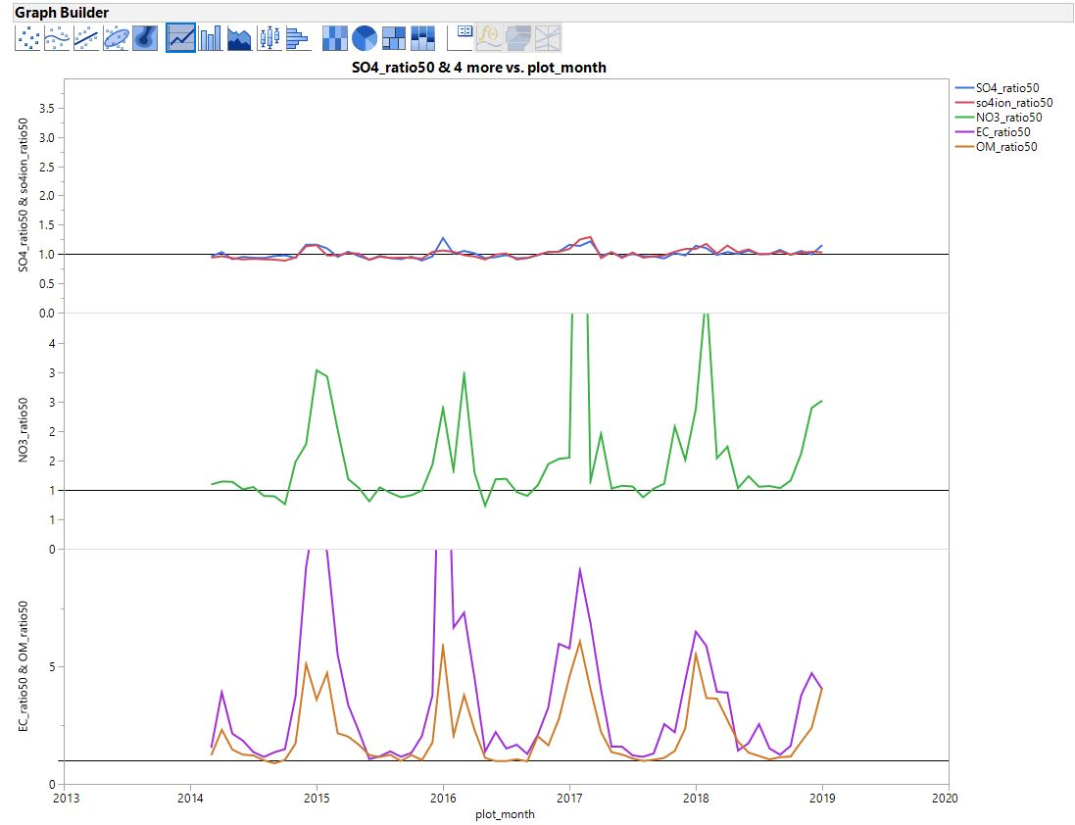
Site Affected: Lake Tahoe Community College (LTCC1) (not a regional haze tracking site)
Issue: 7/1/2014 - 11/17/2015 - the B module stack was "not fully lowered" in the T during that period.
Note that if the air at the stack “T” is like the air at the inlet and no extra nitric acid is getting around the denuder, we would expect the data to be basically the same since it still goes through the cyclone.
After examining the period affected and comparing with nearby BLIS1 data, and at the request of an analyst working for the sponsoring agency, I’ve passed the data through as valid for daily extinction and RHR metric calculations.
Approximate period affected

Slide 33
Changes to IMPROVE RHR Calculations and Metrics after changing only “patching” routine
Results are graphically displayed in
“Compare 12_2019_1p with 12_2019_2p.pptx”
Available here
https://drive.google.com/open?id=0Bxfj1vyyXeDYWVpfeUo4NEYtTU0
Scott Copeland 12_19_2019

Slide 34
Extended Patching
RHR Guidance based “patching” algorithm was extended to allow up to two missing components of aerosol extinction at one site on one date to be replaced per the guidance technique, rather than just one.
The test is performed for each missing component independently, not combinations of missing components as was described in the 2003 guidance.
This change is a response to a request by LADCO analysts in 2017 to allow a subset of important sample dates to be used in progress determinations and is a reasonable extension of the guidance technique.
This change is the minimum modification to the patching algorithm that can still recover most of the important sample dates at the LADCO sites.
About 2200 additional sample dates are recovered at various sites since 2000.
At the IMPROVE Steering Committee meeting in Petaluma and at the National Regional Haze meeting in St Louis, I recommended allowing three components per day to be replaced, but changed to two after a careful inspection of the results, especially at high elevation western sites.
Every patched or substituted value is now reported explicitly with each data version for each affected site and date. See All_patches_12_19_2p.csv and subs_rhr_5_2019.csv on Google Drive.
 | Reported Data | Clearest Days | Most Impaired Days | 2000-2004 Baseline | Natural Conditions Estimates | 2064 endpoints
Significance of change | n/a | mostly minor-some moderate-one high | mostly minor-some moderate-one high | minor | minor | minor
Number of sites affected | - | potentially all | potentially all | next slide | next slide | potentially all

Slide 35
More about the baseline period
Below left are all the class I area sites that had at least one observation changed in the baseline period. All of them could have changes to baseline values, natural_conditions2 values, endpoint values, and impairment metrics.
  In most cases the changes are very small.
The largest changes by a wide margin were at MONT1 (Bob Marshall, and Mission Mountains Wilderness) in Montana.
  The large change at MONT1 results from a few added high fire days that changed the min95 carbon threshold, which then changed the impairment values in most years.
Chart site=MONT1
ACAD1 AGTI1 BAND1 BOWA1 BRCA1 BRET1 BRIG1 CHAS1 CHIR1 CRLA1 DENA1 EVER1 GICL1 GRCA2 GRGU1 GRSM1 GUMO1 HALE1 HAVO1 HEGL1 HOOV1 ISLE1 KAIS1 KALM1 LAVO1 MELA1 MEVE1 MONT1 MOOS1 OKEF1 PASA1 PMRF1 PORE1 REDW1 SAMA1 SAWT1 SENE1 SHEN1 SHRO1 SIPS1 SNPA1 SULA1 SWAN1 THSI1 TRCR1 TRIN1 TUXE1 UPBU1 VOYA2 WHPA1 WHPE1 YELL2 YOSE1

Slide 36
Historical changes after this slide

Slide 37
Changes to IMPROVE RHR Calculations and Metrics since 10/2019 version before changing patching routine
Results are graphically displayed in
“Compare 10_2019 with 12_2019_1p.pptx”
Available here
https://drive.google.com/open?id=0Bxfj1vyyXeDYWVpfeUo4NEYtTU0
Scott Copeland 12_19_2019

Slide 38
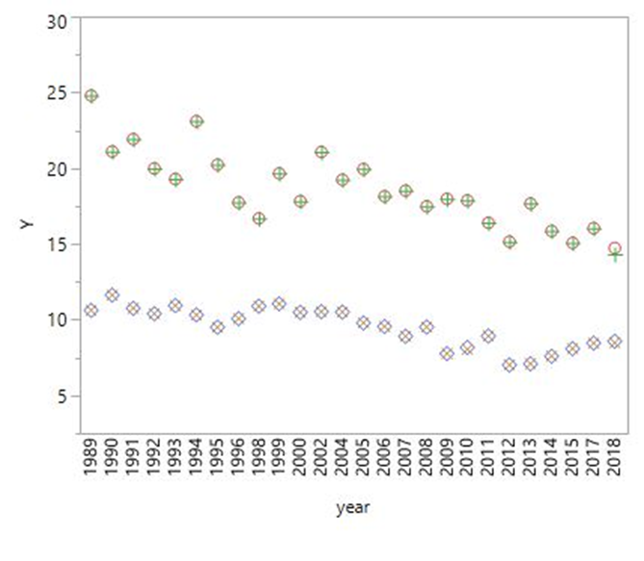

UCD limited data redelivery
Several sample dates with erroneously missing XRF values at 8 sites for parts of 2018 were restored.
Missing IC data for three days at AGTI1 in 2018 were restored – all three days remain invalid for RHR metrics.
LOST1 Lostwood NWR, ND - 08/26/2017-12/31/2018, A module only.
WICA1 Wind Cave NP, SD - 07/1/2018-12/31/2018, B module only.
  -> Status flags were set to “SA”. Data from LOST and WICA are still used provisionally for RHR metric calculation.
Cumulative effects of all three issues:
 | Reported Data | Clearest Days | Most Impaired Days | 2000-2004 Baseline | Natural Conditions Estimates | 2064 endpoints
Significance of change | minor | very minor | Moderate at PORE1, minor everywhere else | n/a | n/a | n/a
Number of sites affected | AGTI1, BLIS1, BRCA1, MORA1, PORE1, REDW1, SEQU1, WHPA1, YOSE1 | 9 | 9 | - | - | -
Chart site=PORE1

Slide 39
Modification of legacy status flags at four sites
“SA”* codes were changed to “TU”* codes for all four modules at 4 sites in 2002 or 2006 after a review of my notes indicated that the “SA” code had been assigned before the “TU” code was in use. “TU” is used to indicate timers that are set up to 24 hours off of the correct time. These reflagged observations are now used for RHR metrics.
At AGTI1, SULA1 and KAIS1, adding these days allowed 2006 to meet the completeness requirements, which they previously did not. BALD1 2002 had already been completed through data substitution.
 | Reported Data | Clearest Days | Most Impaired Days | 2000-2004 Baseline | Natural Conditions Estimates | 2064 endpoints
Significance of change | high | high | high | minor | minor | minor
Number of sites affected | AGTI1, SULA1, KAIS1, 2006 and BALD1 2002 | AGTI1, SULA1, KAIS1, 2006 and BALD1 2002 | AGTI1, SULA1, KAIS1, 2006 and BALD1 2002 | BALD1 | BALD1 | AGTI1, SULA1, KAIS1, and BALD1
*“SA” means “Sampling Anomaly” and is used to describe a wide range of issues including obvious impacts from unusual sources or sampler issues. Data is normally delivered to FED but not used for RHR calculations.
*“TU” is used to indicate controller clocks not set to the correct time. Since the “TU” flag was created, these observations have been considered valid for RHR metrics. Care should be taken to remove them from analyses that depend directly on the timing of the sample, e.g. comparisons with other monitors.

Slide 40
Typo
Corrected a long standing typo in the RHR data patching algorithm. The effect was a small random error in determining whether sea_salt patching was allowed. Only sea_salt patching was affected. Only applicable to a small fraction of observations where sea salt wasn’t already valid.
 | Reported Data | Clearest Days | Most Impaired Days | 2000-2004 Baseline | Natural Conditions Estimates | 2064 endpoints
Significance of change | n/a | very minor | very minor | very minor | very minor | very minor
Number of sites affected | - | potentially all | potentially all | potentially all | potentially all | potentially all

Slide 41
Addition of new combined haze tracking site
RHR metrics now include a “SYCA_RHTS” site code which is the combined trending site that treats SYCA1 and SYCA2(which began 24OCT2015) as a single site with no data modification.
This was based on an analysis that I performed and shared with AZDEQ of the two sites’ data compared with nearby sites.
2015 is now a “complete” year for the hybrid site.
 | Reported Data | Clearest Days | Most Impaired Days | 2000-2004 Baseline | Natural Conditions Estimates | 2064 endpoints
Significance of change | n/a | High | high | n/a | n/a | n/a
Number of sites affected | - | SYCA_RHTS 2015 only | SYCA_RHTS 2015 only | - | - | -

Slide 42
Addition of EPA 2019 results to my default 2064 endpoint file
I am now including the output of the 2019 EPA modeling effort in my 2064 endpoint file for every class I IMPROVE site.
This is for convenience in evaluating the numbers for myself and the community.
I haven’t evaluated the numbers and how they interact with the glide slopes yet.
The most recent version of that file is “endpoint_2064_imp_g_90_12_19_2p.csv”

Slide 43
Changes to IMPROVE RHR Calculations and Metrics between 5/2019 and 10/2019 versions

Slide 44
Modified chloride calculation
Chloride algorithm updated prior to 10_19 version to reflect dramatically reduced IC chloride artifact after 2003.
 | Reported Data | Clearest Days | Haziest Days | Most Impaired Days | Natural Conditions Estimates | 2064 endpoints
Significance of change | very minor | very minor | very minor | very minor | very minor | very minor
Number of sites affected | all | all | all | all | all | all
The old way
Chloride=chlf/1000;
Chlorine=clf/1000;
Sea_Salt=1.8*Chloride;
if ((year le 2003) and (chlf < chlf_mdl or chlf=.)) then Sea_Salt=1.8*Chlorine;
if ((year gt 2003) and (chlf < chlf_mdl or chlf=.) and (clf ne .)) then Sea_Salt=1.8*Chlorine;
A “.” represents a missing observation
The new way

